Slide 1
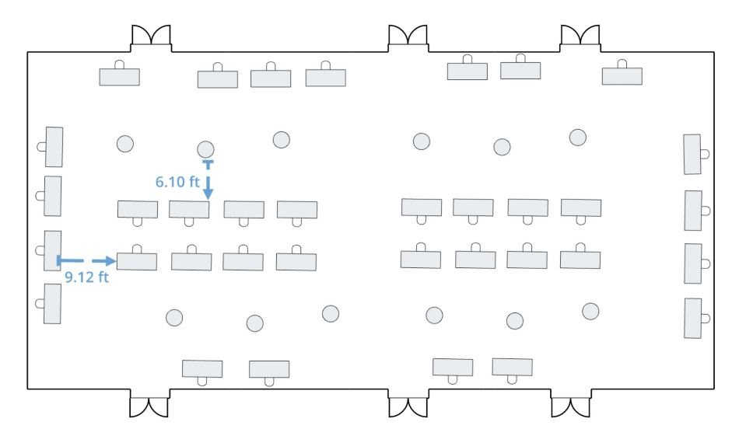
2021 NEC/AAAE Annual Conference
Exhibit Hall
5
6
7
8
9
10
11
4
12
3
35
31
30
29
28
34
33
32
13
2
20
21
22
23
24
25
26
27
14
1
15
19
18
17
16
= booth reserved

